Slide 1
CAPSTONE PROJECT – CSE4099 Stock Analysis and Prediction using scraped news articles on a Deep Learning architecture Review 1
By – Ronet Swaminathan
Reg. No.- 16BCE1166
Project Guide – Prof. Sridhar R.

Slide 2
Problem Statement
To solve real world scenario of predicting stock market using new articles from the Internet.
We do not always have a good dataset to know about the details of the stock market, and here predicting using news articles can be a very effective way to gain fast and effective insights.

Slide 3
Project Objectives
Scrape textual news data and historical numerical stock data for a period of time from the internet using frameworks like BeautifulSoup, Selenium etc.
To predict stock movement using the mined text data, do analytics on it and provide deeper insights simply not possible through numerical values.
Apply transfer learning between textual and numerical datasets.
To make sense of numerical stock data and predict using textual news data by incorporating algorithms of sentiment analysis and deep learning.
Try to extend the project to use real-time stream data.

Slide 4
Feasibility Study
Technical Feasibility
The project has some of the components done before hand. For example, a lot of work has been done on sentiment analysis in different fields. Additionally, we can also find several different NLP techniques to optimize our solution.
We can combine different elements of deep learning and existing sentiment analysis techniques.
News articles can also be collected into a knowledge database for future use cases. This enhances reusability of both data and code.
Financial Feasibility
Apart from the cost of using the internet to scrape news articles, there is no additional cost associated to this project. As the project grows and goes to industrial scale, there will be a need for additional cloud resources for TensorFlow i.e. a more powerful GPU and lots of RAM.
Since the project is a POC (proof of concept) project, we can ignore charges associated with API (Premium) usage.
Duration Feasibility
Project possible to execute in a span of 4 months (December - April).

Slide 5
Existing System – Project Analysis
Technologies like Natural Language Processing and Machine Learning have been used extensively in different domains. Previously, everything has revolved around sentiment analysis to analyse stocks and similar products. But, the use of deep learning (a relatively budding concept) and transfer learning has not been extensively ventured into in context of stock exchange.
Dev Shah, Haruna Isah and Farhana Zulkernine from the Queens University, Canada have published a paper titled Predicting the Effects of News Sentiments on the Stock Market. In this paper, they have retrieved, extracted, and analyzed the effects of news sentiments on the stock market. Their main contributions included the development of a sentiment analysis dictionary for the financial sector, the development of a dictionary-based sentiment analysis model, and the evaluation of the model for gauging the effects of news sentiments on stocks for the pharmaceutical market.
Using only news sentiments, they achieved a directional accuracy of 70.59% in predicting the trends in short-term stock price movement.

Slide 6
Existing System (contd.)
In the paper, News-based supervised sentiment analysis for prediction of futures buying behaviour published by researchers at Indian Institute of Management Rothak and Lucknow, they examine the predictability of real-time news data on investors’ buying behaviour in the futures market, using supervised sentiment analysis.
Market sentiment or traders’ buying behaviour is captured at the bid-ask stage of price formation using the net buying pressure (NBP). Any significant change in NBP patterns defines an “interesting market event”. Real-time news headlines are automatically labelled using interesting market events, assuming a lag between the market information and its impact on buying behaviour.
News was found to have an impact on the market buying behaviour of the S&P NIFTY index futures with an optimal lag of 5 minutes. Manual labelling of the news data validated this empirical finding.

Slide 7
Existing System (contd.)
In the paper ‘SANA: Sentiment analysis on newspapers comments in Algeria’, the authors are interested in their work by comments in Algerian newspaper websites. For this end, two corpora were used; SANA and OCA. SANA corpus is created by collection of comments from three Algerian newspapers, and annotated by two Algerian Arabic native speakers, while OCA is a freely available corpus for sentiment analysis. For the classification, they have adopted Supports vector machines, naïve Bayes and k-nearest neighbors.
From this study, they deduce the importance of dedicated resources and methods for newspaper comments sentiment analysis.

Slide 8
Proposed System
We can see a pattern here - several studies have been done in the past to cumulate data from news sources and make predictions through it. The most popular use case is sentiment analysis where one can create surveys about user sentiments and use it to gain insights in political, business and educational domains.
In the recent time, with the boom of social media, it is becoming easier to collect user data. For eg., Facebook and Twitter publish some open user data every year for developers to make analysis on it (APIs). This was indeed the case when researchers at Facebook and Twitter partnered with US Security Forces, were analysing through individual posts in Syria to identify objectional content. This was done to screen out potential terrorists and curb terrorist activities.
With such advances in mind, I look to implement a similar function to a business-related problem, mainly building a deep-learning based stock prediction mechanism using data from textual news articles.

Slide 9
Proposed System (contd.)
In this project, I propose to create an analysis cum prediction model to assess stock movements through scraping news articles. Here, I will be scraping stock related news articles, general business articles for certain companies whose stocks are prominent etc. I will then also scrap historical data of these company stocks from a finance website.
So, I will be working with a mixture of textual as well as numeric data. This will correspond to 2 different datasets. Now there will be a propagation of knowledge between the datasets, where I plan to use sentiment analysis on the textual data and use that to predict a “mood” index, which in turn will decide how the next day stock forecast will change.

Slide 10
Proposed System (contd.)
Previous works have already made prediction models for this problem, but there, stocks have been previously updated and predicted using a time series model where there is a continuous stream of daily highs and lows for a given number of stocks over a period of time using conventional machine learning models.
The novelty in my work is that I am using 2 completely different parameters to predict stocks, that are news as well as time series. This model will then be trained over a neural net using TensorFlow.

Slide 11
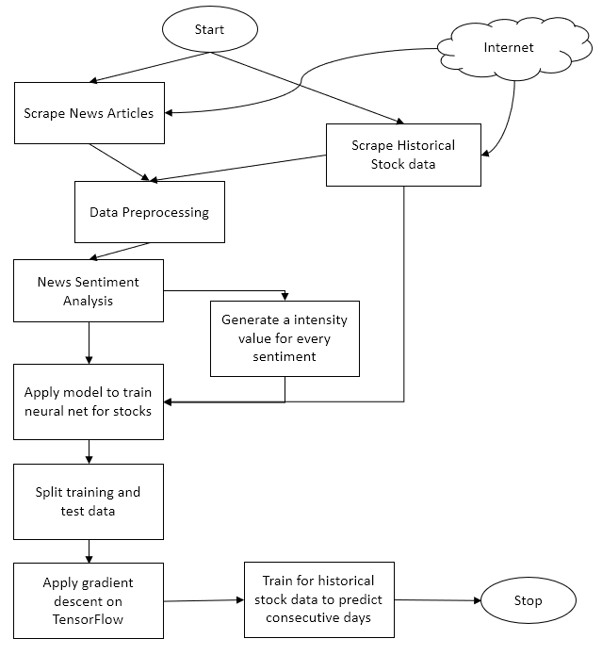
Engineering Design
A flowchart that simplifies the architecture of the project.

Slide 12
Possible Constraints
Since I’m using top 500 grossing stocks for this project, I need to scrape both stock values as well as news articles for all 500 of them (5 years each). This increases time required and can create delays.
Issues with multiple requests to the website. Possibility that the website blacklists our scraper. Need to go for a trial and error approach to find the best websites.
Additionally, a single news source is not enough. We need a minimum of 2 to 3 sources for our stocks related news to reduce bias.
Need to see how to use the sentiments acquired (for gradient descent) from the news articles on the historical stocks data. Probably need to design a scale to map sentiment intensities.

Slide 13
Technical Implementation steps taken
Literature surveys done to know the state of existing works in the field.
Historical stock data has been scraped from websites like Quandl and Yahoo Finance. The stocks are dated from 2012 to 2018 (i.e. 5 years of stock data)
Analytics has been done on the extracted stock data. Several statistics like risk and return trends, moving average and correlation measures have been deduced.
Following are some of the graphs and related code that has been implemented.

Slide 14
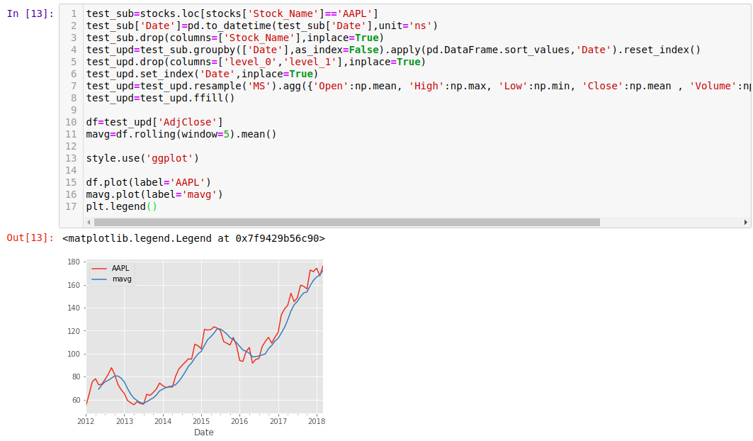
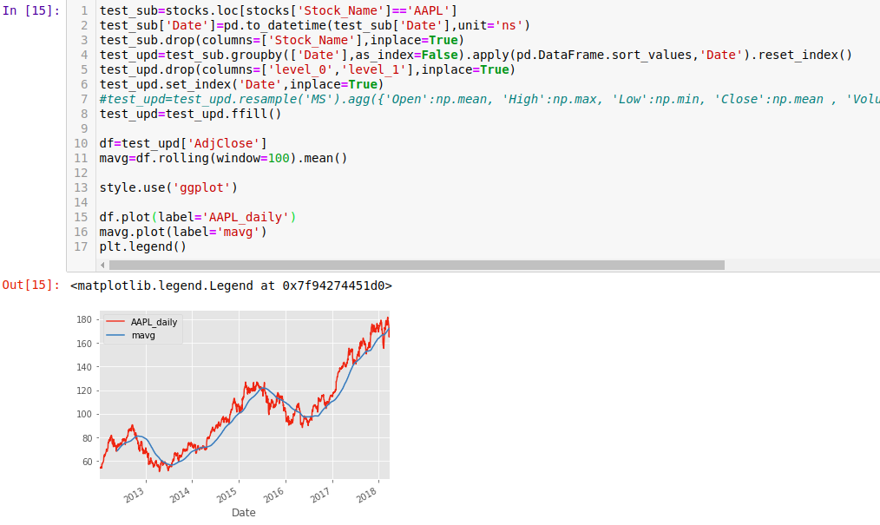
Apple Stock trend – resampled by month and through moving average with rolling window = 5
Apple Stock trend – preprocessed raw from scraped data and its moving average with rolling window = 100

Slide 15
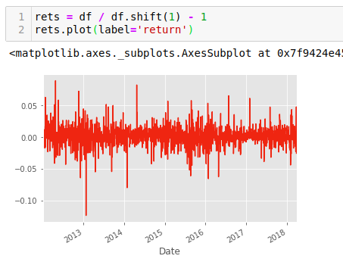
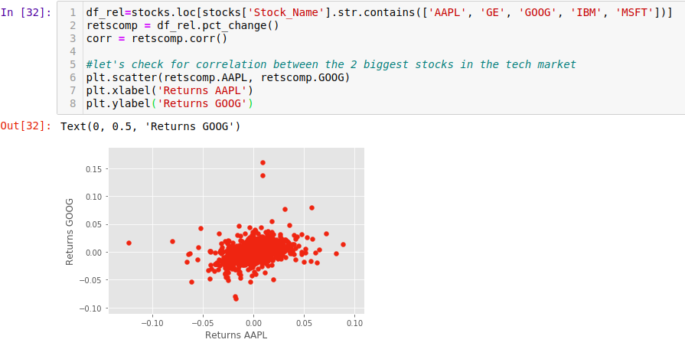
Apple Stock trend – returns graphed for the scraped time period by standardized formula
Correlation between Apple and Google stock

Slide 16
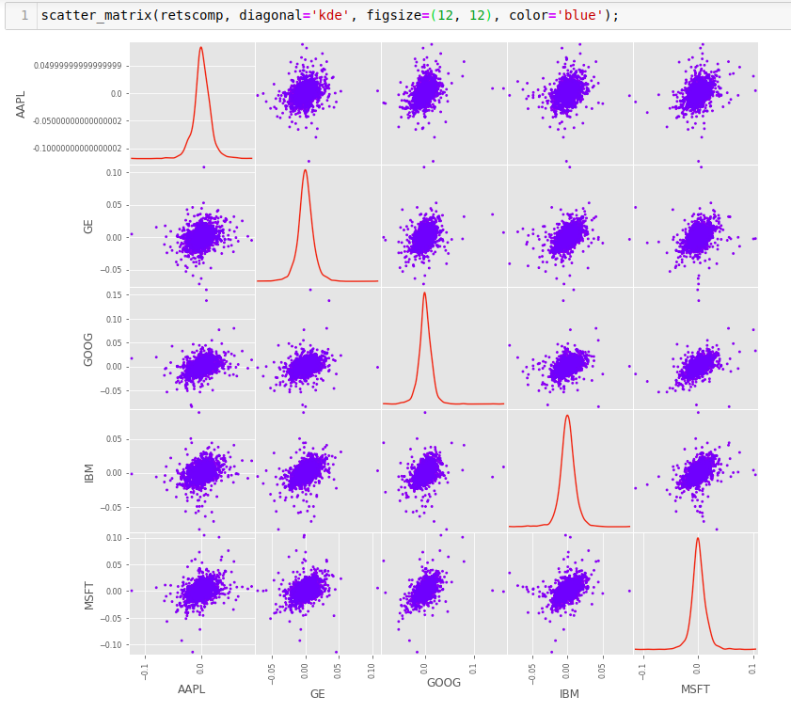
Correlation Scatter Matrix between the dominant stocks

Slide 17
THANK YOU

Slide 18
Extras
Formulas Used (Graph):
Return(t)= (p(t)/p(t-1))-1, where p(t) is closing value for a particular time
Metrics that can be used:
RMS error
Krippendorff’s Alpha: a=1-(D(o)/D(e))
D(o) – Disagreement observed, D(e) – Disagreement Expected

